Slide 1
ENSE 471, Milestone 2
Walmart Greeters
Taylor Petrychyn, Daris Lychuk, Priscilla Chua
March 13, 2019

Slide 2
Team (re)introductions
Team members
Daris Lychuk 4th year SSE student
Taylor Petrychyn 4th year SSE student
Priscilla Chua 4th year SSE student
What’s your team name?
Walmart Greeters

Slide 3
Brainstorm #1
How many different ideations did your team explore?
Created 12 in total, 4 each
Rationalize the number of ideations your team created
Some slight overlap, but all focus on their specific customer’s needs
Discuss if you incorporated the “digital constraints” Glenn talked about, re: Cascade Server in your ideations or not and why
Can’t change top header, can’t change footer
Why did you select the storyboard/lo-fidelity prototype (or some other) approach for your ideations (was it good, bad, better if…?)
Lo-fi is quick and easy to hand draw and still conveys the look and feel of the design

Slide 4
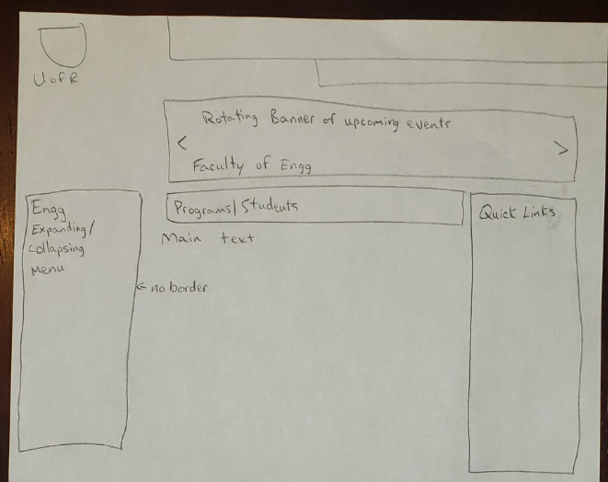
Lo-fi #1

Slide 5
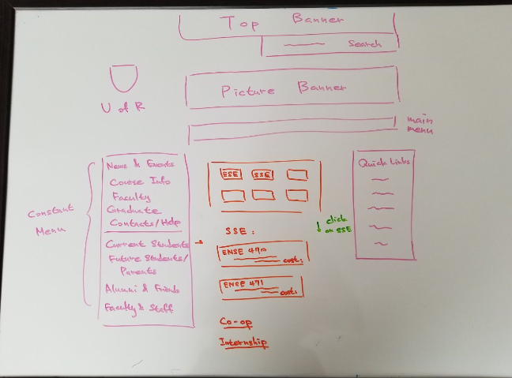
Lo-fi #2

Slide 6
Evaluate #1
Liked rotating banner of upcoming events, but wanted better placement of certain categories
Talked about grad students keeping the social media as well as the upcoming events up to date.

Slide 7
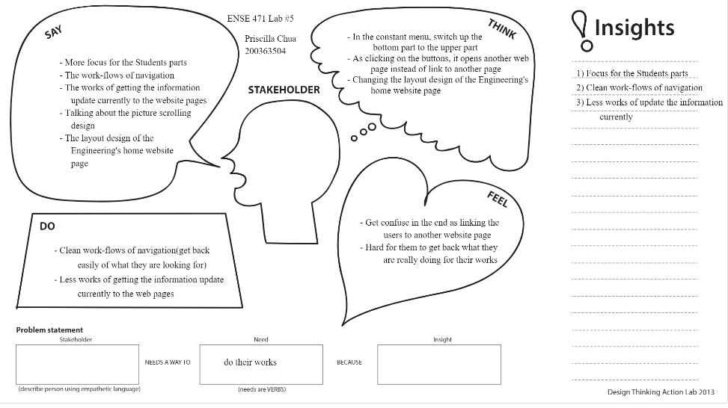
Empathy Map - Current Students

Slide 8
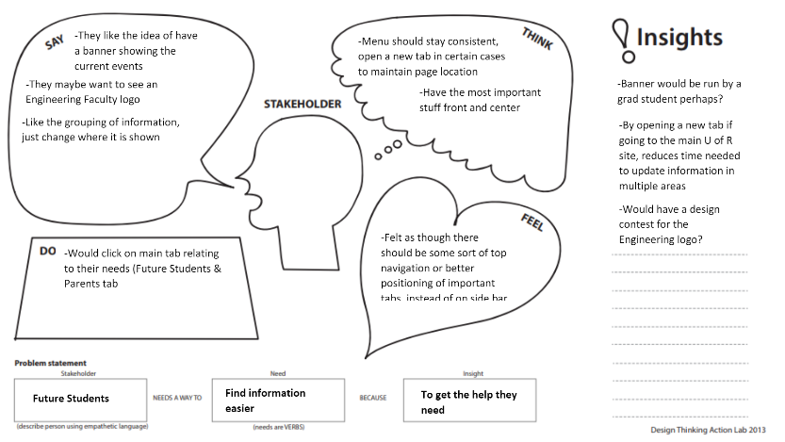
Empathy Map – Future Students

Slide 9
Empathy Map – Grad Students

Slide 10
Current Student Usability Questions
What classes do I need to take next semester?
Where is the faculty office?
Where/how do I register for my classes?
Can I apply for counselling or help completing my program?
Apply for co-op
How do I sign in to Hercules/Hyperion, and VPN to the school?

Slide 11
Future Student Usability Questions
Can you find information to help you compare whether you’d like Environmental over Industrial?
Tell me the prerequisites to apply to UofR Engineering.
What jobs are available in an SSE degree?
How many disciplines does ESE offer?
What is the expected cost of tuition?

Slide 12
Graduate Student Usability Questions
What are the requirements to become a graduate student?
How much does the Software graduate program cost?
Can you tell me what programs are offered for graduate students?
What is the research focus or specialty of Tim Macaig?
Can you find where to apply? Specifically, forms and contact information?

Slide 13
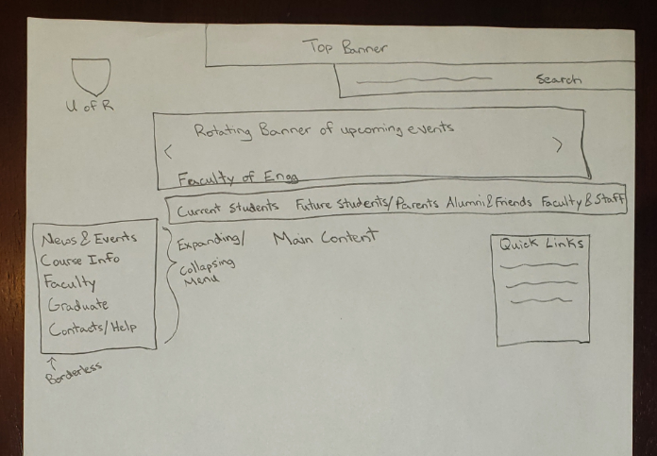
Brainstorm #2 - Focused Ideation

Slide 14
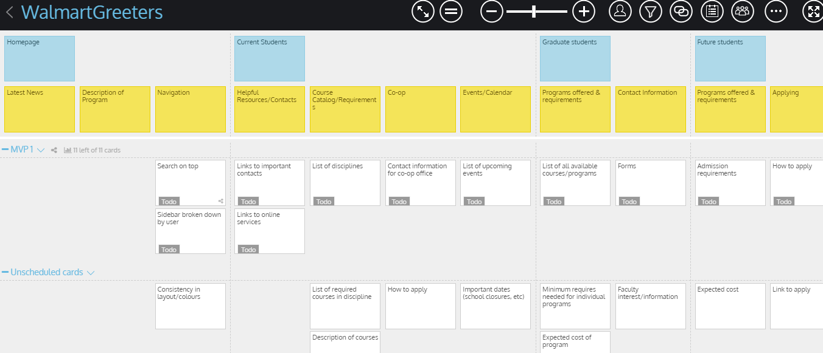
Brainstorm #2 - USM

Slide 15
GitHub review
https://github.com/darislychuk/Walmart-Greeters/tree/master/milestone%202

Slide 16
Group Reflection
How did you feel about this milestone? What did you like about it? What did you dislike?
Felt rushed, lots of work piled on the last milestone
What did you learn about yourself as you collaborated and worked through this milestone?
We like getting feedback from customers/users throughout design, it keeps the vision on track

Slide 17
Group Reflection Continued
How will you use what you have learned going forward?
Usability questions are valuable in gaining insight
Quick mockups save time in the long run
What “stuff & things” related to this milestone would you want help with?
Unsure about constraints of Cascade server, some features are likely not possible.
Have a way to implement more complicated features

